Slide 1
Presented by Kadali Harshavardhan IITRPRAI_24091956 IIT ROPAR
AI IN PERSONALISED LEARNING
Transforming Education Through AI-Powered Personalization

Slide 2
One-size-fits-all approach → limited personalization
Teachers struggle to adapt for large classrooms (30+ students)
Feedback is delayed until exams → learning gaps remain hidden
Content difficulty is static, not adaptive to progress
No clear tracking of student learning journeys
PROBLEM STATEMENT

Slide 3
AI-powered adaptive learning system for personalized education
Three ML models for classification, prediction & engagement
Real-time feedback within <100ms
Streamlit-based student interface for easy access
Scalable architecture → supports 100+ concurrent learners
SOLUTION OVERVIEW

Slide 4
Data Input: Student interactions, quiz results, learning history
AI Analysis Engine: Learner classification, performance prediction, engagement scoring
Recommendation Engine: Personalized study plans, difficulty adjustment, motivational tips
Student Interface: Streamlit app with clean, responsive design
SYSTEM ARCHITECTURE

Slide 5
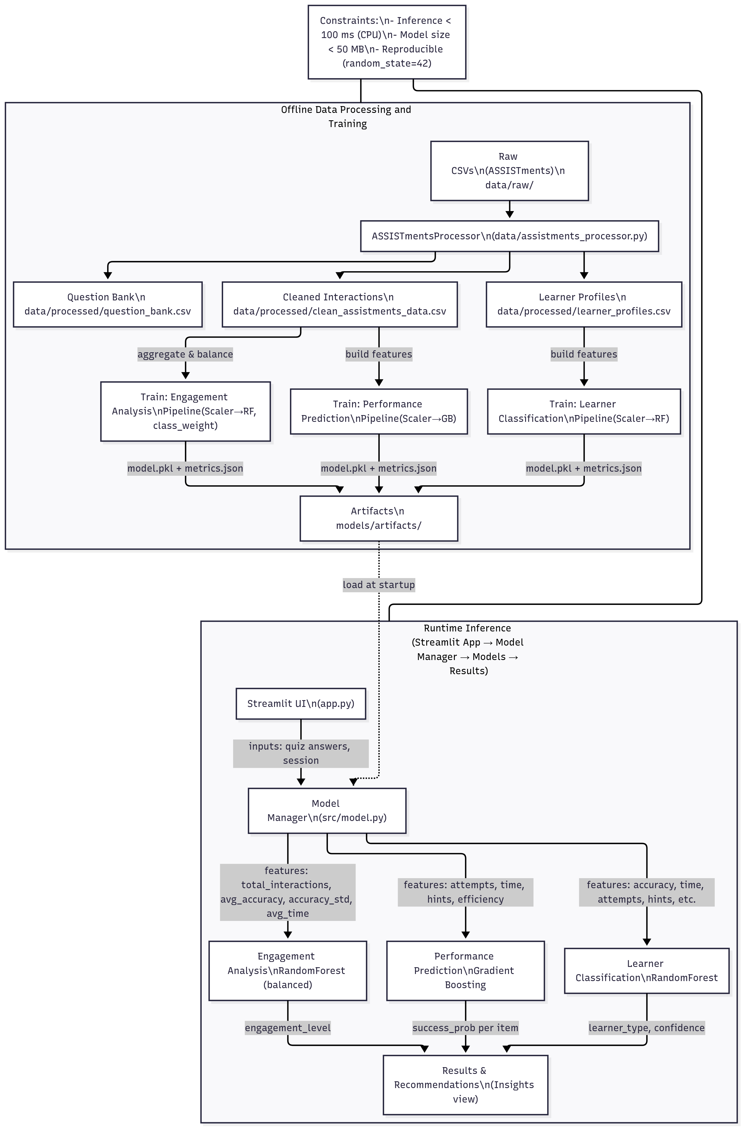

Slide 6
Learner Classification → Identifies advanced, balanced, struggling learners
Performance Prediction → Anticipates success/failure on upcoming tasks
Engagement Analysis → Measures motivation and consistency
Optimized inference → <100ms latency
AI MODELS

Slide 7
Dataset: ASSISTments educational data (2000+ records)
Feature engineering: Accuracy, speed, attempts, engagement metrics
Balanced training → fair across all student types
5-fold cross-validation for reliable results
Reproducibility ensured with fixed seeds
METHODOLOGY & DATA PIPELINE

Slide 8
Real-time AI-powered insights (<100ms)
Personalized recommendations & adaptive difficulty
Smart engagement scoring (0–100) with clear breakdown
Student progress tracking & visual dashboards
Multi-user scalability for classrooms
KEY FEATURES

Slide 9
Tech stack: Python, Streamlit, Scikit-learn, Plotly
Modular architecture → separation of concerns (data, models, UI)
Lightweight model artifacts (<50MB each)
Error handling & fallback mechanisms for reliability
Optimized memory & CPU usage
TECHNICAL IMPLEMENTATION

Slide 10
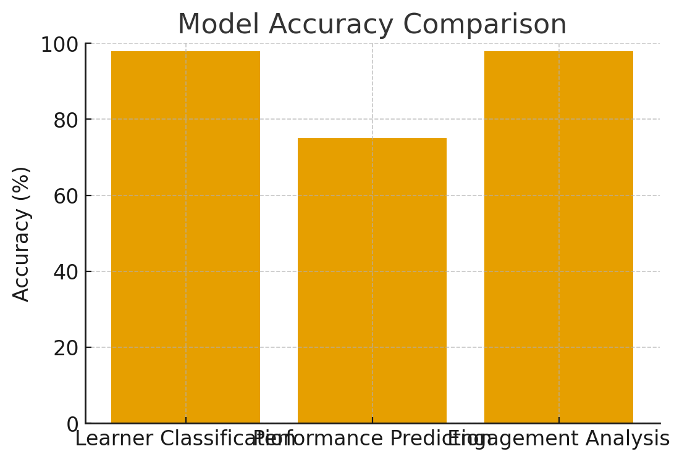
Learner Classification → 98% accuracy
Performance Prediction → 75% accuracy, ROC-AUC: 0.79
Engagement Analysis → 98% accuracy
Average response time → 23–54ms per model
End-to-end pipeline latency → <100ms
RESULTS & PERFORMANCE

Slide 11
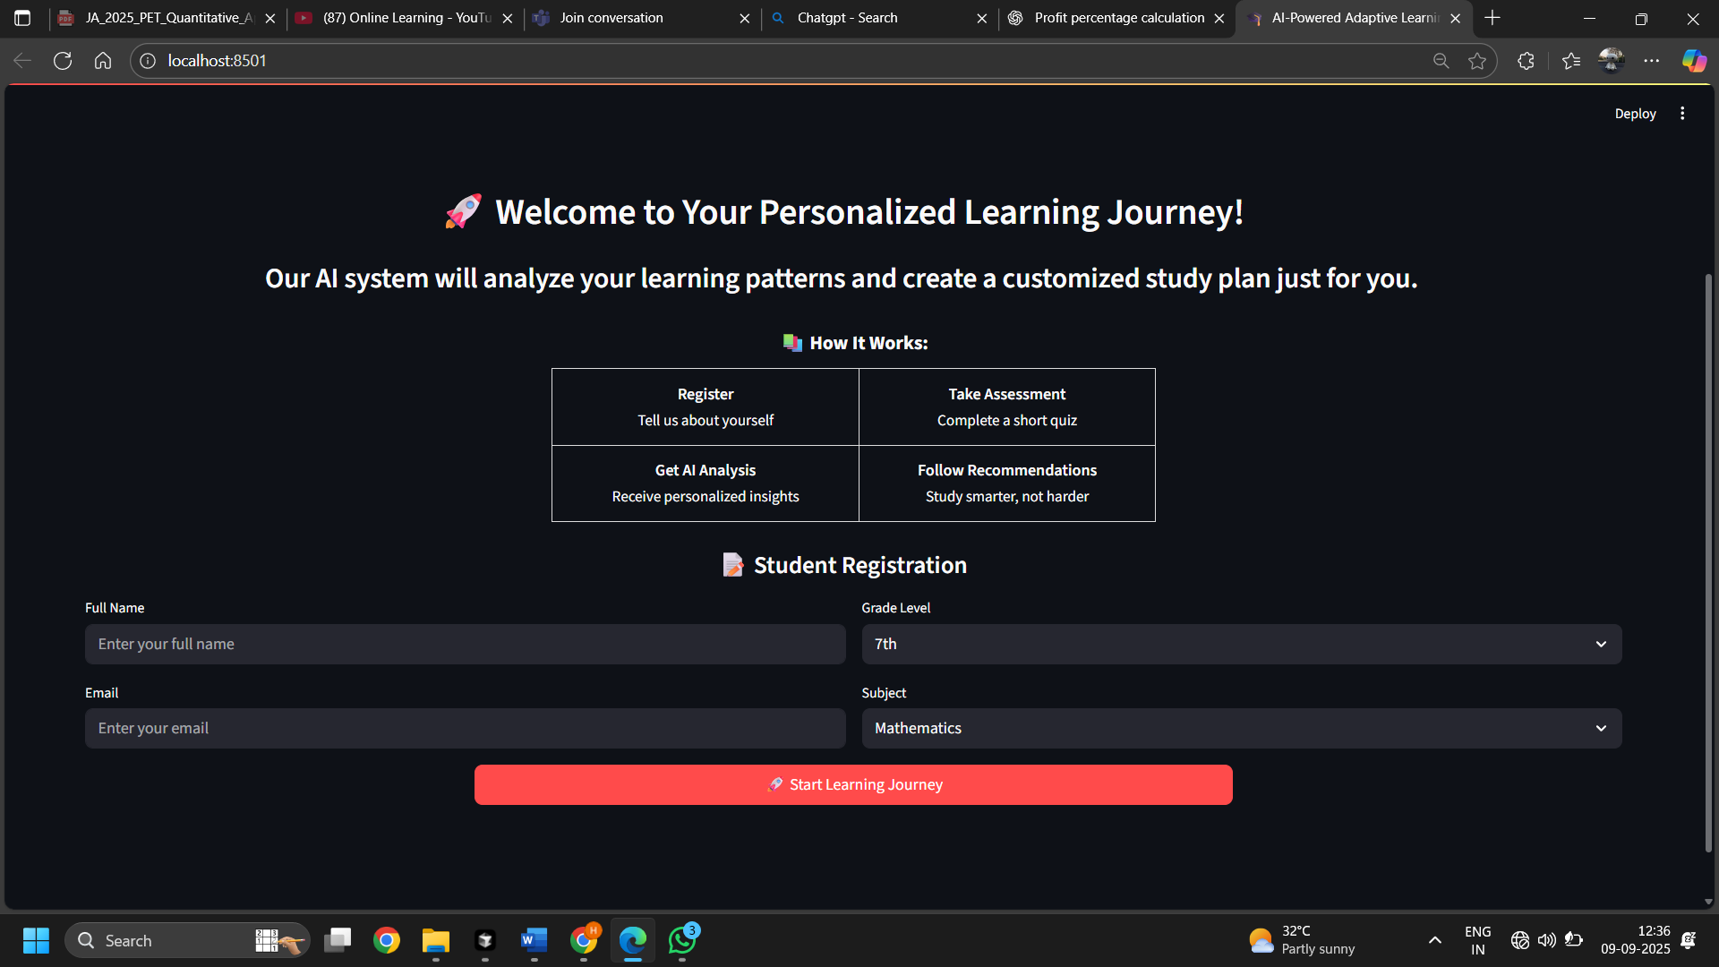
Screenshots

Slide 12
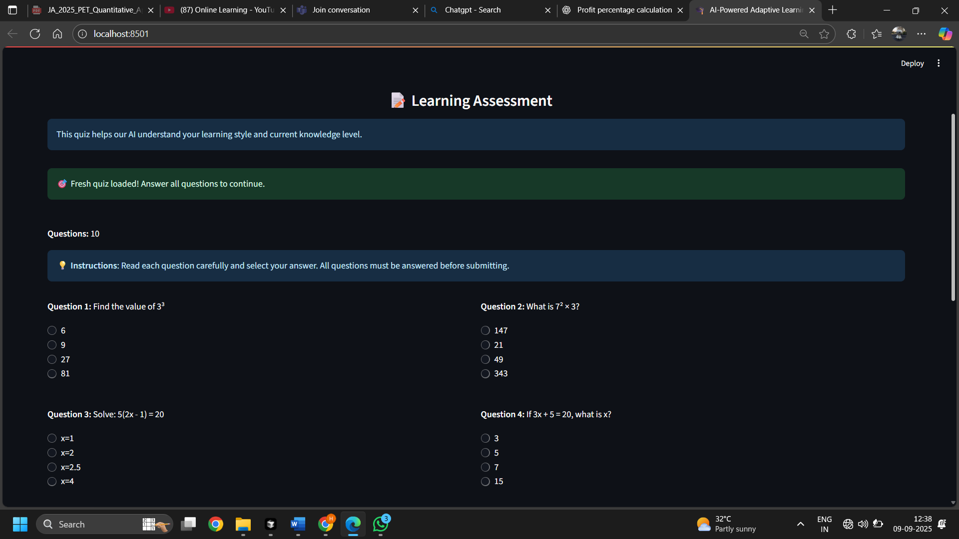

Slide 13
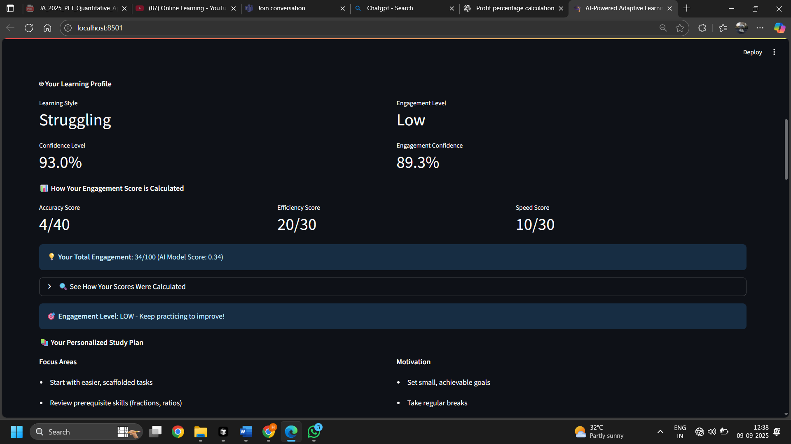

Slide 14
Students → Personalized learning, real-time feedback, motivation
Educators → Data-driven insights, early intervention, efficiency
Institutions → Scalable, cost-effective, modern AI-powered system
Outcome → Improved learning & engagement
IMPACT & BENEFITS

Slide 15
Short-term → RAG integration, deep personalization
Mid-term → Multi-modal learning, LMS integration
Long-term → AI tutor, predictive learning paths, enterprise deployment
Technical roadmap → cloud deployment, microservices, advanced ML models
FUTURE WORK

Slide 16
Fully functional prototype exceeding targets
Real-time, scalable, and production-ready
Student-centered approach ensures adoption
Foundation for future AI-powered education systems
CONCLUSION

Slide 17
Thank you!
Ready to transform education through AI-powered adaptive learning Presented By Kadali Harshavardhan iitrprai_24091956 IIT Ropar

